Slide 1

QUORA CLONE APP
DONE BY :
Adithya Holla -4NM19CS007
Arsh Imtiyaz Assadi -4NM19CS032

Slide 2

INTRODUCTION
Quora app is a user-friendly application.
The platform will help anyone who’s looking for answers they can’t find on the internet.
The main aim of the project is to bring people together and form a community which helps each other share knowledge.
To avoid this problem our Questioner App help the them to post their questions in the app and get their answer or solutions to their questions.

Slide 3
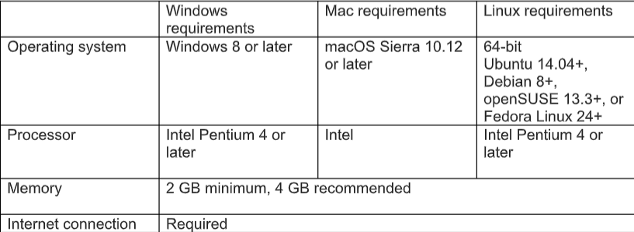
HARDWARE/SOFTWARE REQUIREMENTS

Slide 4
HARDWARE/SOFTWARE REQUIREMENTS
Operating System | : Windows 10, Windows 11
Browser Workspace | : Google chrome latest version : Android Studio
Programming Language | : Java
Documentation | : MS-Word

Slide 5
METHODOLOGY
JAVA :
Java is the technology of choice for building applications using managed code that can execute on mobile devices.
Android is an open source software platform and Linux-based operating system for mobile devices.
The Android platform allows developers to write managed code using Java to manage and control the Android device.
Android applications can be developed by using the Java programming language and the Android SDK.

Slide 6
METHODOLOGY
FIREBASE :
Firebase is a real time data base which allows to store tree of lists of objects.
It allows to synchronize data between different devices.
We must configure and integrate firebase into our application and provide access by a set of rules written in a JSON configuration language to store the data in this real time database

Slide 7
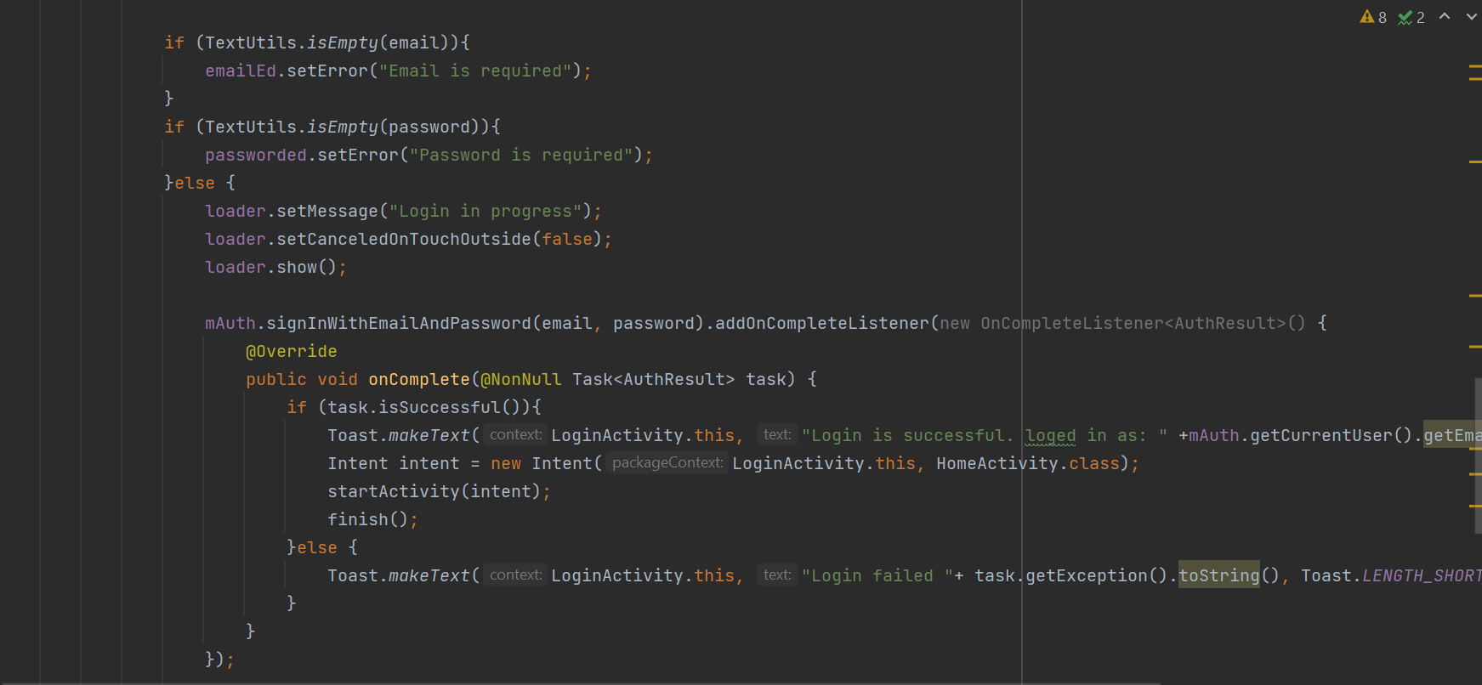
IMPLEMENTATION

Slide 8
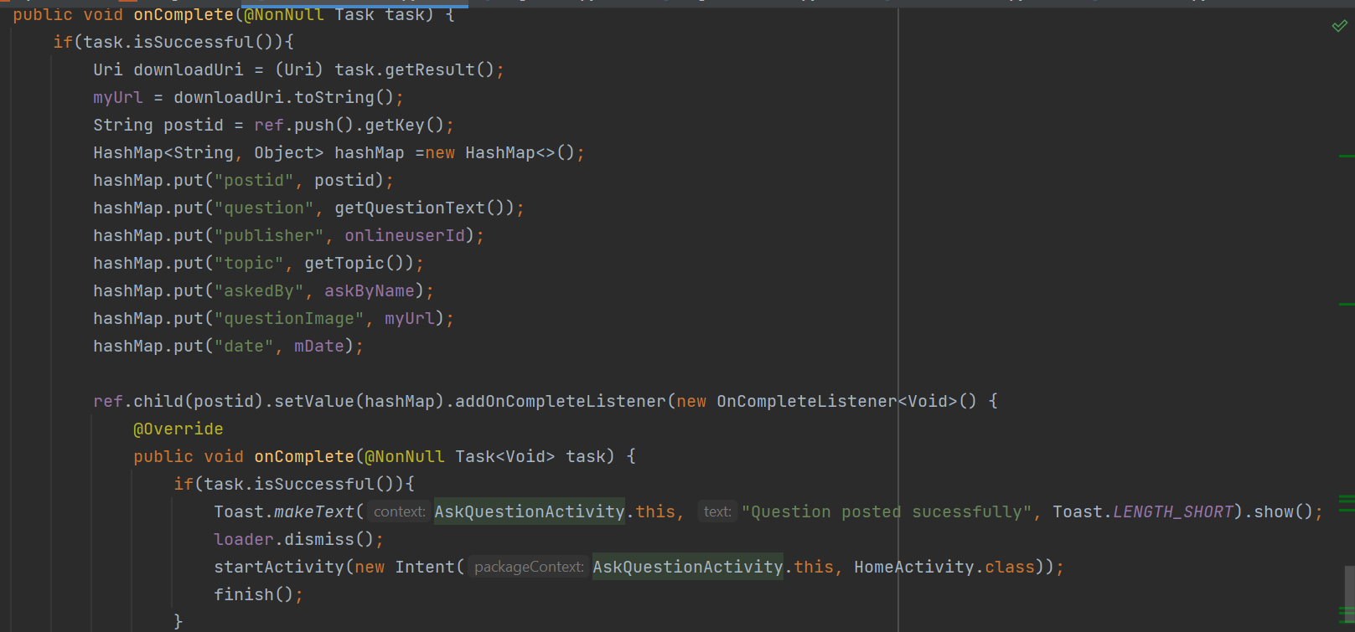
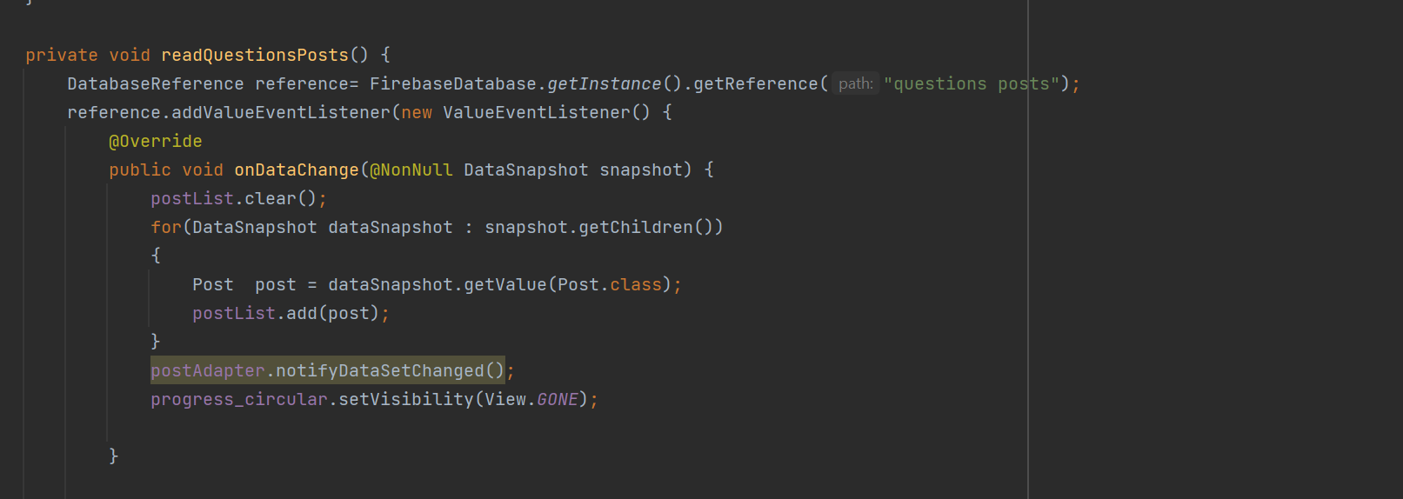
IMPLEMENTATION
Asking Question Question Post

Slide 9
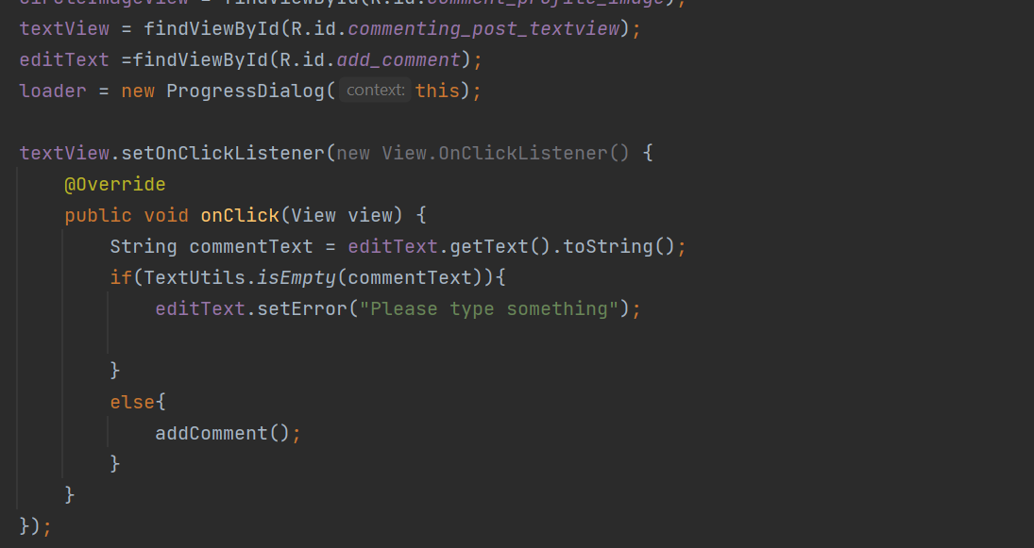
IMPLEMENTATION
Commenting Answer

Slide 10
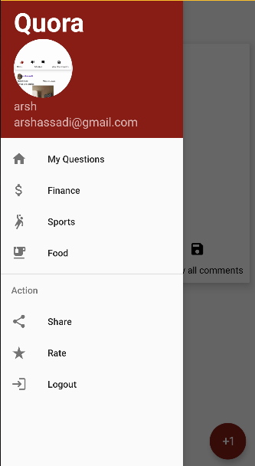
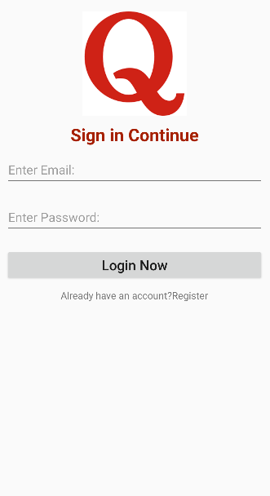
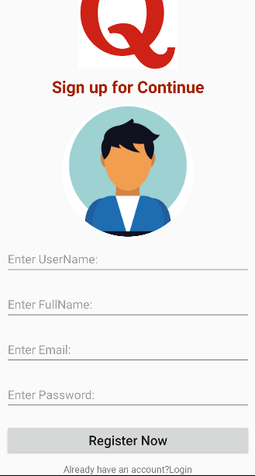
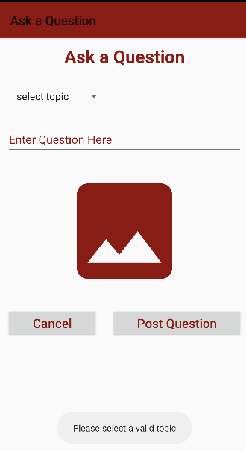
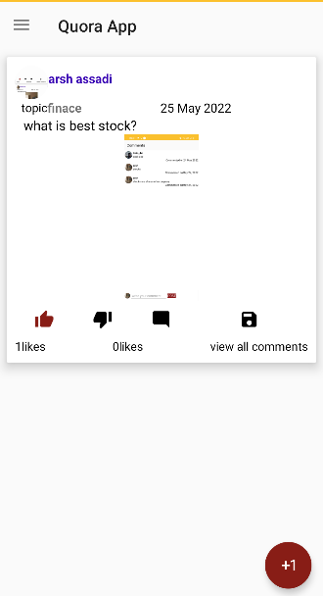
RESULTS OF APP
Login Page Registration Page Asking Question Page Question View Nav BarView

Slide 11
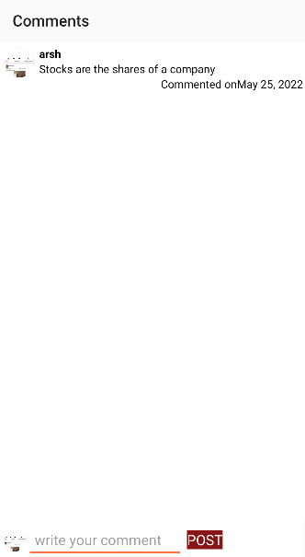
RESULTS OF APP
COMMENT ACTIVITY

Slide 12
RESULTS OR CONCLUSIONS
Quora clone app where you login and ask questions an choose the topic
The User can post pictures related to the question.
The User can comment the answers of the questions he has seen in the post.
The User can like/ dislike the question asked .

Slide 13


